Slide 1
South Carolina legislator briefing
Bruce rew, PE
Senior Vice president of Operations
August 30, 2022

Slide 2
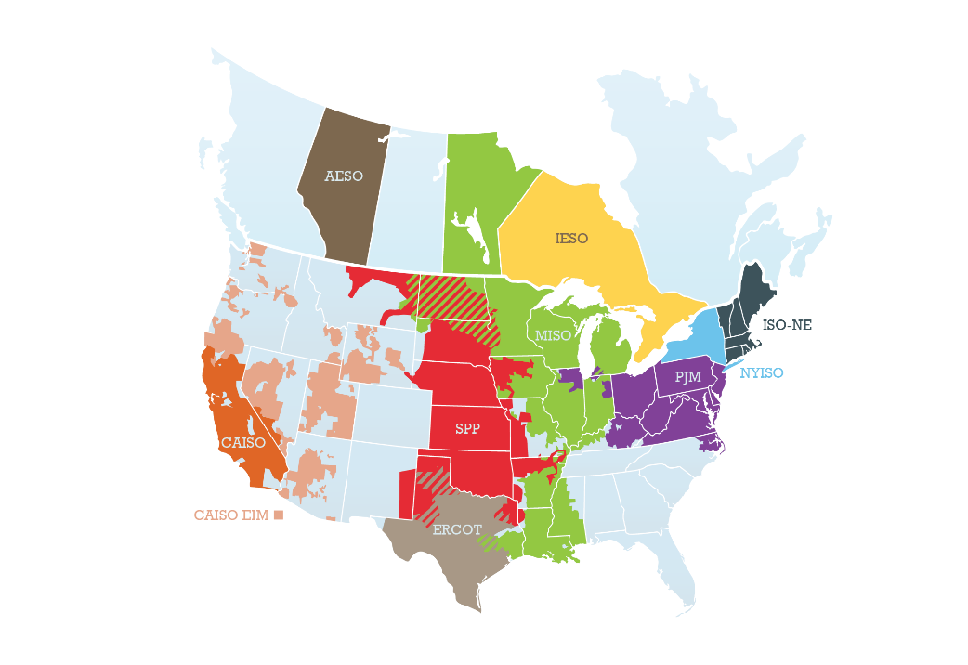
Regional transmission organizations/
Independent system operators

Slide 3
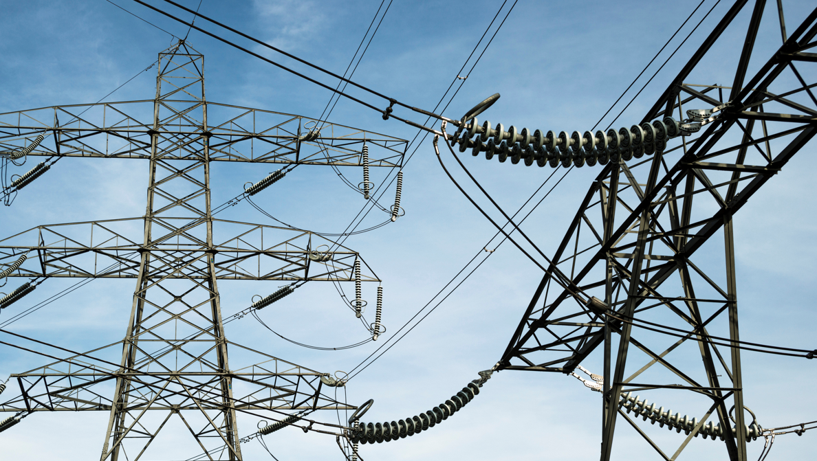
WHO IS SPP?
Spp does not
501(c)(6) not-for profit corporation
One of 9 regional grid operators
113 member companies in 14 states
“Air traffic control” for high-voltage grid
Balances supply and demand across region
Maintains reliable grid operations
Operates wholesale energy market
Plans future transmission needs
Own or operate grid infrastructure
Serve end-use customers
Set generation prices
Set retail electricity rates

Slide 4
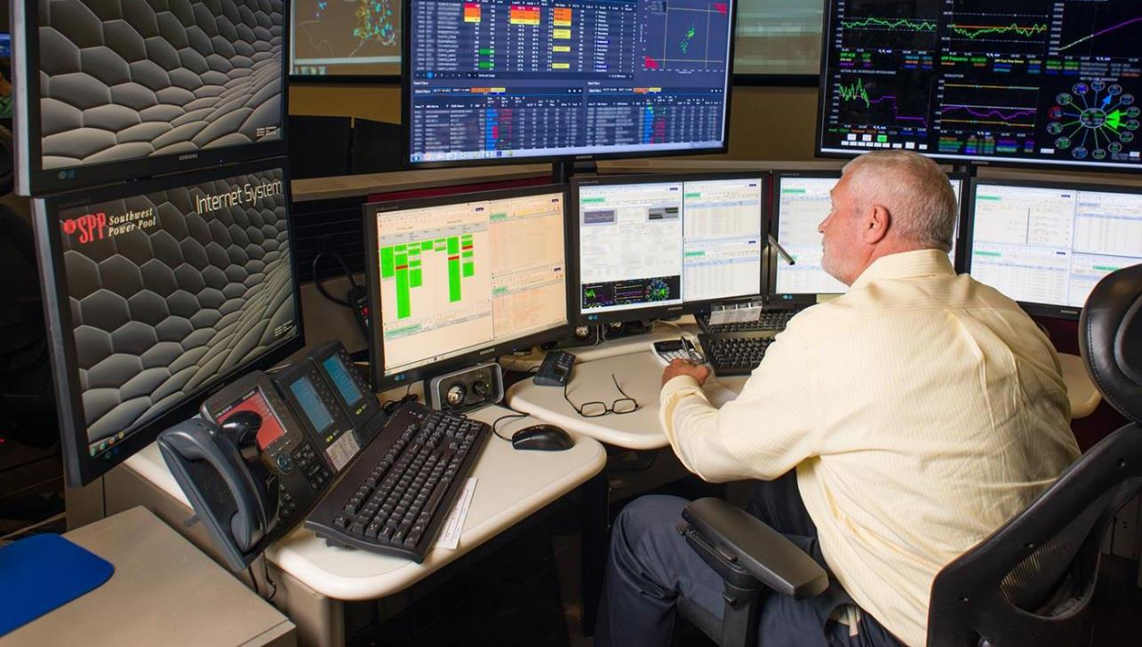
81 years of milestones
1941 Formed to support war effort
1968 NERC Regional Council
1980 Telecommunications network
1991 Reserve sharing
1994 Nonprofit status
1997 Reliability coordination
1998 Tariff administration
2004 RTO status
2007 EIS market
2009 Nebraska joins
2010 Regional cost allocation
2010 Integrated Transmission Planning
2013 Regional Balancing Authority
2014 Integrated Marketplace
2015 Integrated System joins
2019 Western Reliability coordination
2020 Resource adequacy-NW Power Pool
2021 Western EIS market

Slide 5
Collaborative stakeholder process
Board of Directors/Members Committee
Regional State Committee
Membership
Staff
Committees
Cost Allocation Working Group
Markets & Operations Policy
Working Groups
Corporate Governance
User Groups
500+ stakeholders drive decisions & strategic direction
Rosters represent member diversity
Open stakeholder forums
Finance
Human Resources
Advisory Forums
Oversight
Advises Board & Committees as needed
Strategic Planning
Notes:
More than 500 stakeholders are involved in SPP’s organizational structure of committees, working groups, and ad hoc task forces. This member involvement drives SPP’s decision-making and strategic direction.
Any and all opinions are heard loudly and clearly in organizational group meetings. The rosters of our organizational groups match the diverseness of the membership, requiring representatives from across the footprint and recognizing different member types and sizes.

Slide 6
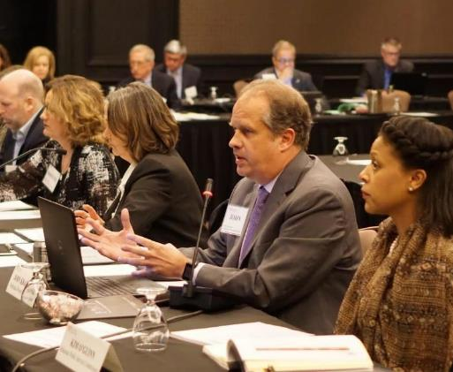
Regional State Committee
Retail regulatory commissioners from:
Arkansas | Missouri | Oklahoma
Iowa | Nebraska | South Dakota
Kansas | New Mexico | Texas
Louisiana | North Dakota
Primary responsibility for:
Cost allocation for transmission upgrades
Approach for regional resource adequacy
Allocation of transmission rights in SPP markets

Slide 7

Reliability Coordination:
“air traffic controllers” of bulk power grid
Monitor grid 24 x 365
Anticipate problems
Take preemptive action
Coordinate regional response
Independent operation
Comply with 5,500+ pages of reliability standards and criteria
Notes:
SPP independently operates the regional wholesale power grid under rules and regulations of the North American Electric Reliability Corporation and the Federal Energy Regulatory Commission. SPP doesn’t own the electric transmission grid. Similar to how air traffic controllers monitor airspace, we monitor the grid 24x7 to maintain electric reliability and mitigate grid emergencies. We constantly analyze computer models that show us the current state of the electric grid for an eight-state region - such as lines in service, generators operating, and voltage levels - so we can be prepared for the next worst contingency or emergency that could occur.
Our reliability coordinators follow over 5,500 pages of reliability standards, and are authorized to decisions to protect overall power grid infrastructure and ensure the lights stay on.
(We monitor the large transmission lines, not the distribution lines that go to homes.)

Slide 8
Spp markets
Transmission Service
Participants buy & sell use of transmission lines owned by different parties
Integrated Marketplace
Participants buy & sell wholesale electricity in day-ahead & real-time
Day-Ahead Market commits cost-effective & reliable generation for region
Real-Time Balancing Market economically dispatches generation to balance real-time generation & load while ensuring reliability
Western Energy Imbalance Service Market
Contract-based, real-time balancing market in Western Interconnection
Consolidated Balancing Authority operates as a single region
Notes:
8
8

Slide 9

RTO West
Western Energy Imbalance Service (WEIS) Market
Markets+
Western Reliability Coordination Service
Western Interconnection Unscheduled Flow Mitigation Plan
7 organizations joining RTO in 2024; expected $49M annual savings for new & existing members
Launched Feb. 2021; 3 new members joining in 2023 bringing load to 13.5 GW
New real-time/day-ahead market in development with western parties (will replace WEIS)
Maintaining reliability for 13 western transmission operators
Helping 6 western organizations manage grid congestion
Western Resource Adequacy Program Operator
Partnering with Western Power Pool to ensure resource adequacy
Reinforce system reliability
Achieve clean energy goals
New opportunities to trade low-cost power
Provide economic benefits
Maintain resource adequacy
Notes:
How does all of this fit together?
RA Programs
Wholesale markets
Transmission funding
13 minutes of opening remarks
Rebecca
Lanny
Michele

Slide 10
Market Options
SPP’s West option:
SPP MARKETS+
Real-Time Markets:
SPP RTO
Transmission Planning
Transmission Planning
Transmission Planning
BAA Consolidation
BAA Consolidation
BAA Consolidation
Transmission Service Provider
Transmission Service Provider
Transmission Service Provider
Resource Adequacy
Resource Adequacy
Resource Adequacy
Reliability Coordinator
Reliability Coordinator
Reliability Coordinator
SPP: WEIS
Day-Ahead Market
Day-Ahead Market
CAISO: EIM
Real-Time Market
Real-Time Market

Slide 11
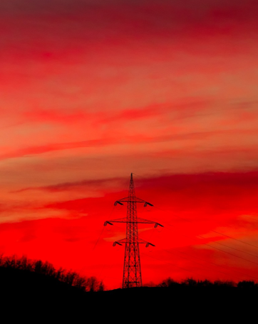
What questions do you have?
Bruce Rew, PE
Senior Vice President, Operations
BRew@spp.org

